Slide 1
Anti-Discrimination Working Group
Meeting #4
Friday 18 August 2023
10.00, NCRR main meeting room (and online)

Slide 2

Agenda
Introduction round (7 min)
Aims of the group (3 min)
Recap: Polygenic embryo screening (10 min)
Thought experiments & discussion (30 min)
Ideas for next meeting (5 min)

Slide 3
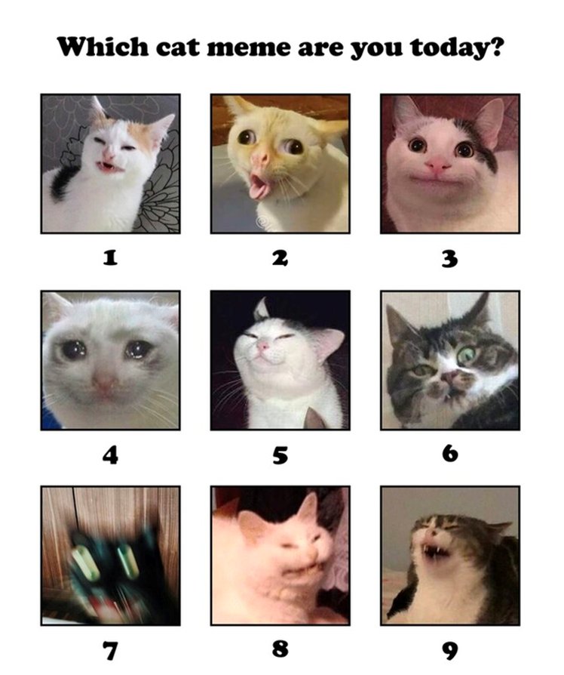
Introductions

Slide 4
Aims of the group
To strive for equality
To strive for diversity
To be open & transparent
To be mindful that the topics we discuss may be triggering and upsetting, impacting on people in different ways.
This is not a passive intellectual topic. It takes time to install the correct support and find solutions. This is a learning process.
To discuss ongoing issues with discrimination in research
To recognize harmful structures and practices of discrimination in research
To advocate for changes that promote equity in research

Slide 5
Recap: Polygenic embryo screening
Discrimination in genetics research →
Intertwined history of eugenics and (psychiatric) genetics →
Genetic testing and polygenic embryo screening

Slide 6
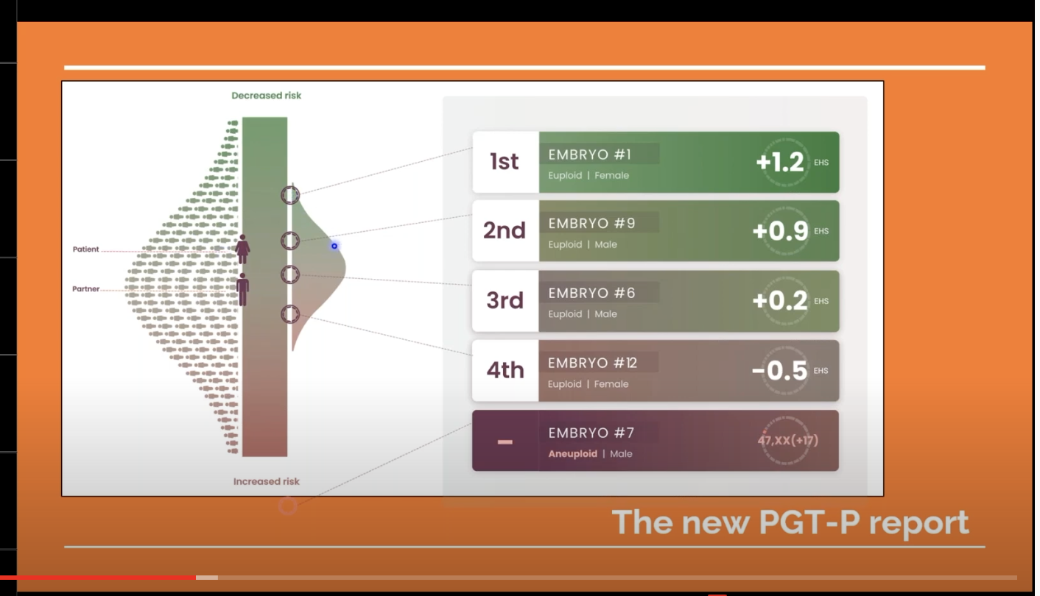
Polygenic embryo screening (PES)
The application of polygenic risk scores in the context of PGT, in order to determine each embryo’s liability for one or more diseases/traits, and to guide selection of an embryo for implantation (Lencz et al., 2022)
Screenshot from Genomic Prediction presentation [Online image]. (2021). Center for Genetics and Society. https://www.geneticsandsociety.org/biopolitical-times/first-polygenic-risk-score-baby
Notes:
Great discussion piece: https://journals.library.columbia.edu/index.php/bioethics/article/view/9467
First child born after use of PES with company GenomicPrediction, AKA “LifeView”: https://www.lifeview.com/
News article: https://www.geneticsandsociety.org/biopolitical-times/first-polygenic-risk-score-baby

Slide 7
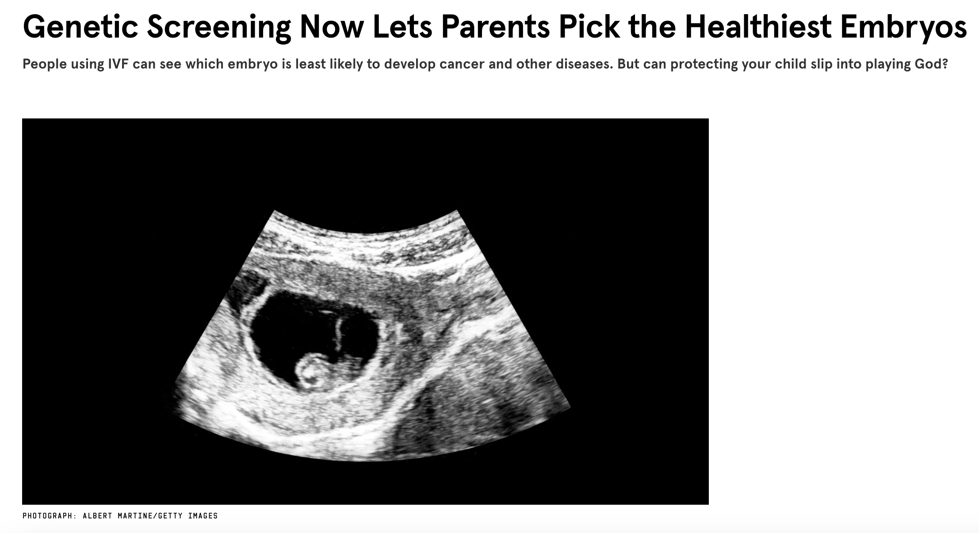
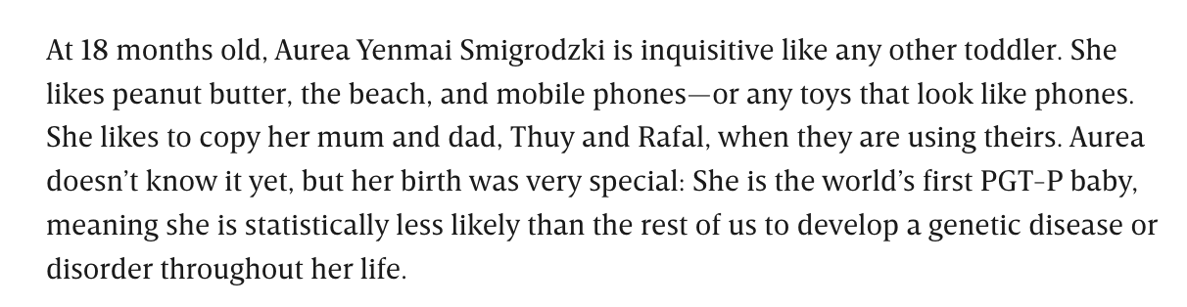
Polygenic embryo screening (PES)
https://www.wired.co.uk/article/genetic-screening-ivf-healthiest-embryos

Slide 8
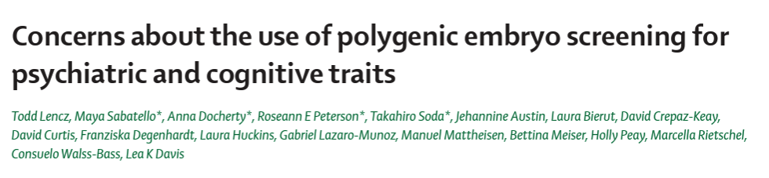
Polygenic embryo screening (PES)

Slide 9
Polygenic embryo screening (PES)
For thirty years, preimplantation genetic testing has been a routine part of IVF.
Identification of embryos with monogenic disease-causing alleles (e.g., CF, Tay-Sachs disease).
PES is a new technique.
Commercially available from at least one provider.

Slide 10
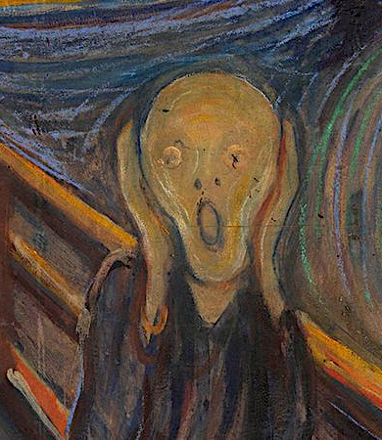
Polygenic embryo screening (PES)
For thirty years, preimplantation genetic testing has been a routine part of IVF.
Identification of embryos with monogenic disease-causing alleles (e.g., CF, Tay-Sachs disease).
PES is a new technique.
Commercially available from at least one provider.

Slide 11

Why should we be concerned about PES?
I don’t see the problem with PES. Surely we want to try and improve the health of the population? If PES is trying to achieve this, what is the problem? How is this any different to PGT and NIPT?

Slide 12
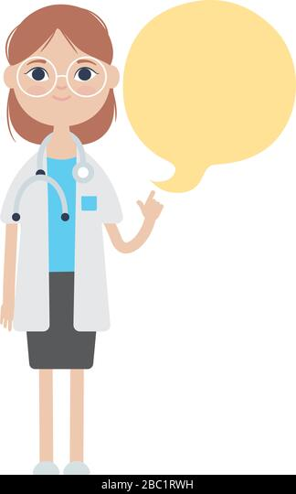
Why should we be concerned about PES?
I don’t see the problem with PES. Surely we want to try and improve the health of the population? If PES is trying to achieve this, what is the problem? How is this any different to PGT and NIPT?
There are many issues with PES.

Slide 13
Why should we be concerned about PES?
I don’t see the problem with PES. Surely we want to try and improve the health of the population? If PES is trying to achieve this, what is the problem? How is this any different to PGT and NIPT?
There are many issues with PES.

Slide 14
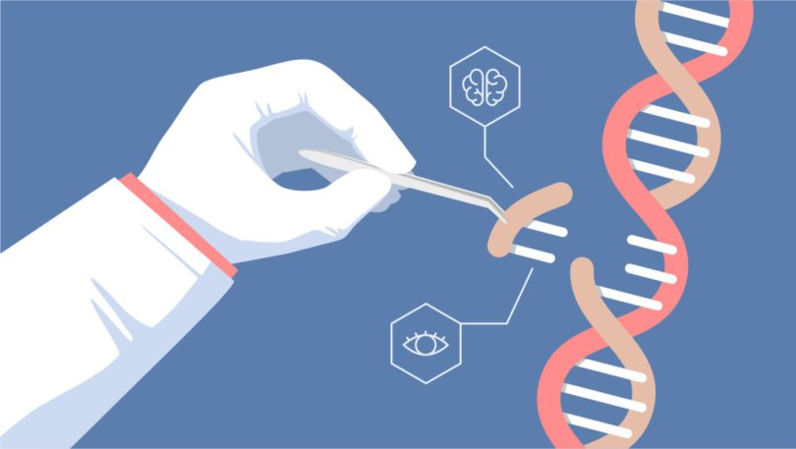
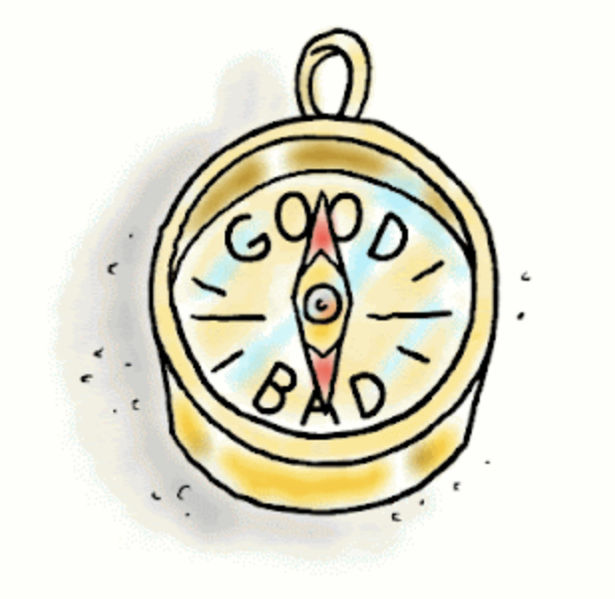
Why should we be concerned about PES?
PES
There are many issues with PES.
Practical/scientific
issues about efficacy
Ethical issues

Slide 15
Practical/scientific issues with PES
Issues with accuracy
1. PES depends on accuracy of polygenic scores (sample size and trait heritability).
2. Variance explained by a polygenic score is much lower than SNP-based h2 (which, in turn, is much lower than broad-sense H2).
3. Polygenic scores are based on GWAS results which may also capture genetic nurture.
4. Polygenic scores are inherently probabilstic and capture risk for multiple phenotypes.
Health disparities*
Regulatory issues
5. Polygenic scores are not transferrable across genetic ancestries.
6. The goals of PES are not clearly defined. What do parents want?
7. No established guidelines on communication of results of polygenic scores, what they mean, and what parents can expect from PES.
8. Regulations differ across countries. This could lead to reproductive tourism.
*Practical and ethical

Slide 16
Ethical issues with PES
Costs to society
1. Encouragement of eugenicist beliefs.
2. Encouragement of genetic essentialism.
3. Encouragement of fatalism.
4. Increased stigma around certain disorders/traits.
Costs to research
5. Need to take into account views of research participants (e.g., in GWASs).
6. Researchers feeling that their contributions have been misused.
7. Distrust of genetics research community.

Slide 17
Statement issued by the International Society of Psychiatric Genetics (ISPG)
ADVISORY ON THE USE OF POLYGENIC RISK SCORES TO SCREEN EMBROS FOR ADULT MENTAL HEALTH CONDITIONS.
Approved by the ISPG Board May, 2021
Several private companies are using polygenic risk scores to screen embryos for adult mental health conditions. The screening is done as part of in-vitro fertilization. A polygenic risk score is a single number that measures part of a person’s genetic predisposition for a condition¹. These genetic scores are built by adding up the small effects from many hundreds or thousands of genes. Although in general higher scores mean you are more likely to have a condition, many healthy people will have high scores; others might develop the condition even with a low score. The accuracy with which a polygenic score can predict psychiatric illnesses, such as schizophrenia, bipolar disorder and major depression, is currently not sufficient for clinical use. Furthermore, the unintended consequences of its use for embryo selection need to be considered. While polygenic risk scores are used in research, there are currently no clinical uses in psychiatry.
The ISPG views with concern the offering of polygenic embryo screening services for psychiatric conditions, for both scientific and ethical reasons. First, polygenic risk scores do not determine whether a person will develop a condition. They measure just one of many possible risk factors. Second, polygenic risk scores are not specific to a single condition. This means that selection for one condition can affect other genetic traits. Third, it is not known how to accurately communicate the level of risk to prospective parents. Fourth, in many countries, there is no regulation or oversight of polygenic embryo screening to protect against misuse, like there is for other kinds of genetic testing. Fifth, screening embryos for psychiatric conditions may increase stigma surrounding these diagnoses. Finally, psychiatric genetics has a history of misuse for eugenics²⁻⁴, and polygenic embryo screening raises many ethical, legal, and social issues that can potentially lead to harm and have not yet been studied or addressed⁵.
While scientific and ethical issues have been widely studied for single-gene embryo testing⁶, the issues listed above have not been explored for polygenic embryo screening. The few published polygenic embryo screening studies have been mostly led by a private company selling these services^{7–11}. Public discussion and debate including all potential stakeholders is urgently needed on a national and international scale. Given these considerations, the ISPG urges caution and calls for additional research and oversight on the use of polygenic embryo screening.

Slide 18
Discussion
Does PES perpetuate societal biases and reinforce notions of genetic superiority/inferiority? Discrimination/stigmatization of individuals with certain traits?
Potential loss of genetic diversity and impact on the wider population due to the selective avoidance of certain disorders/traits?
Impact on genetics research: Will this discourage participation from diverse, under-represented communities and increase the health disparities that already exist?
Are research contributions being misused or applied in a way that we find problematic?
Notes:
Before we jump into these questions, I thought we could have a broader discussion
What do we think about PRS potentially being used in PES?
Someone mentioned in the last meeting that they have been approached at a conference by someone who had recently launched a company that does PES and wanted to potentially collaborate on some work
Does anyone else have any experience with this?
Does this perpetuate societal biases? While PES is purported to be used for the deselection of affected embryos, does this translate to using PES for the selection of superior embryos?
A question I had personally as someone that is new to genetics: Would this lead to a loss of genetic diversity? And would this have an impact on the wider population due to the selective avoidance of certain genetic disorders?
What about the impact on genetics research:
The article we recommended talks about the people who contribute to these GWASs potentially not consenting to data being used in this way. Will this lead to further distrust in genetics research and people from diverse under-represented communities being even less likely than they already are to participate?
What about negative consequences on researchers, if our research is being misused and applied in a way that we find problematic?

Slide 19
Bioethical thought experiments
Taken from Chapter 40 “Red Lines” in The Code Breaker by Walter Isaacson
Context: Gene editing with CRISPR
Also applicable to genetic screening
Notes:
Written in the context of gene editing, but also applicable to genetic screening.
Progression from light gray into darker gray…
Note: the first conditions are monogenic, the later conditions are more polygenic.

Slide 20
Huntington’s disease
Autosomal dominant disease (50% chance if one parent has it)
Caused by an abnormal repetition of letters in DNA sequence
Leads to the death of brain cells
Uncontrollable twitching, progressive loss of focus and motor function, personality changes, sometimes dementia
Symptoms usually arise after childbearing years (no natural selection)
Notes:
Is there an evolutionary role of Huntington’s disease?
Avoid embryonic screening by doing pre-implantation genetic diagnosis of fertilized eggs? → Producing a lot of viable fertilized eggs is not easy…

Slide 21
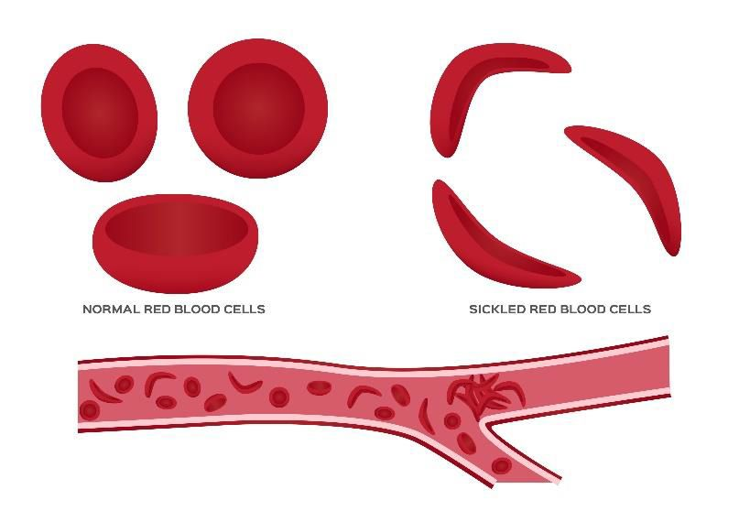
Sickle cell anemia
Recessive disease
Caused by a single nucleotide variant
Leads to malformed red blood cells
Fatigue, infections, spasms of pain, early death
But: One copy of gene → immunity to most forms of malaria
Notes:
Genes may play multiple roles and have evolutionary roles for existing

Slide 22
Character
“Challenges and so-called disabilities often build character, teach acceptance, and instill resilience. They may even be correlated to creativity.”
Notes:
FDR shaped by polio
Jory Fleming shaped by autism: Book How to Be Human; About gene editing to eliminate some of the causes of autism → “You’d be removing an aspect of the human experience, but for what benefit exactly?”; The world is not good at accomodating people whose emotional lives are different.

Slide 23

Deafness
Scenario: Deaf lesbian couple wants to have a baby that is also deaf.
Find a sperm donor who is also congenitally deaf.
Pre-implantation diagnosis to select an embryo made with a typical sperm donor that has the genetic mutation for deafness.*
Gene edit a typical embryo to have genetic mutation for deafness.
Punch out the child’s eardrums after birth.
*What if it was PES?
Notes:
What is a disability?
“Deafness as a part of who someone is rather than something to be cured.”
”Deafness as a subculture that contributes to the diversity and perhaps even the empathy of society?”
What if deafness is not monogenic, and the couple use polygenic embryo screening to get sleect the embryo with the highest chance of also being deaf?
Disadvantages/dangers of being deaf are very real for humans and other animals.
Disadvantages of being LGBTQ+ or Black are “due to social attitudes than can and should be changed.”
What if there were a ”gay gene”?
Being born Black in the U.S. could be seen as a disability → SLC24A5 has a major influence on skin color

Slide 24
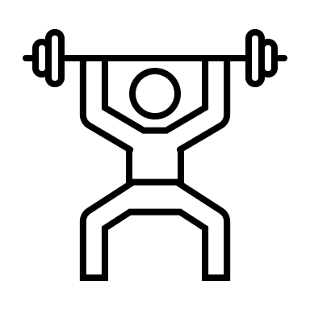
Muscles and sports
MSTN encodes a protein that stops muscle growth when the muscles reach a normal level → when disabled, leads to muscle growth
Rare mutation in EPOR increases number of red blood cells → more stamina
R allele of the ACTN3 gene produces a protein that builds fast-twich muscle fibers → improved strength & recovery from muscle injury
Fairness in athletics?
Notes:
The blurry line between treating true disability and enhancing the traits of our children.
MSTN produces a protein that curtails the growth of muscles when they reach a normal level → edit or select against functional variant to get more muscley children?
Rare gene mutation that increases the number of red blood cells (see Olympic skier Eero Mäntyranta) → select for to get children with more stamina and ability to use oxygen?
What happes to fairness in athletics if the “natural talent” of “natural talent + disciplined effort” is not so natural anymore?
Most champion runners have the R allele of the ACTN3 gene…so does fairness exist in sports in the first place?

Slide 25





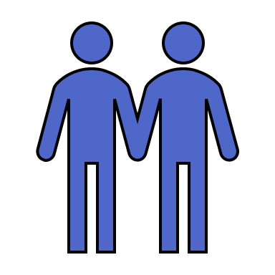
Height
Scenario 1
Scenario 2
Scenario 3
IMAGe syndrome (stunted growth) caused by a mutation in CDKN1C
Parents select against mutation so children will grow to normal height
Parents just happen to be short
Parents select embryo for height so children will grow to normal height
Parents are average height
Parents select embryo for extra height so children will grow to be taller
absolute improvement vs. positional improvement
Notes:
Fairness of editing/selecting for physical enhancements
Absolute improvement vs. positional improvement
Absolute improvement: beneficial to you even if others get the same enhancement
Positional improvement: beneficial to you only if others DO NOT get the same enhancement

Slide 26

Super-enhancements & transhumanism
Eyesight better than 20/20 (e.g., Tiger Woods after laser eye surgery)
Night vision
Resistance to radiation
Resistance to new coronaviruses
Notes:
”Children will become like iPhones; a new version will come out every few years with better features and apps”

Slide 27
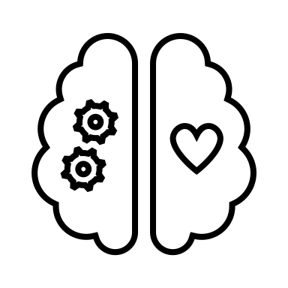
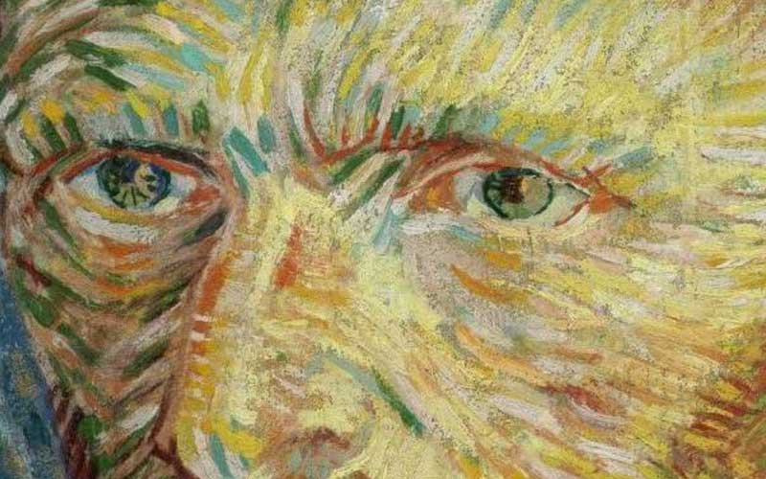
Psychological disorders
If genetic factors predisposing to schizophrenia could be selected against or edited, would that be a good thing?
”To what extent does dealing with mood swings, fantasies, delusions, compulsions, mania, and deep depression help spur, in some people, creativity and artistry?”
“Would you cure your own child from being schizophrenic if you knew that, if you didn’t, he would become a Vincent van Gogh and transform the world of art?”
Notes:
James Watson (of Watson & Crick) and his son Rufus (received diagnosis of schizophrenia) completely for gene editing/selection against schizophrenia (also a huge eugenicist)
Reminder: Vincent van Gogh comitted suicide
What is desired by an individual vs. what is good for human civilization?

Slide 28
Intelligence
Mouse model: enhanced memory by editing NMDA receptor genes in nerve cells
Absolute improvement for human civilization
“Sociogenomics”
Notes:
What is intelligence? Is more always good? How do we measure it?
Fraught topic of genetics of educational attainment and the field of sociogenomics.

Slide 29
What influences how we feel about each scenario?
Gene editing vs. genetic screening
Monogenic vs. polygenic traits (+ pleiotropy)
Curing disability* vs. enhancement
Absolute improvement vs. positional improvement
What is good for the invidividual vs. what is good for human civilization?
*What is a disability?

Slide 30

Ideas for next meeting
Genetic counselling?
Bioethics?
Discrimination at the workplace (academia/research)?

Slide 31



Thanks!
Next meeting:
September?
Jess Mundy
Hannah Chatwin
Alisha Hall
Jette Steinbach
jmundy@clin.au.dk
hchatwin.ncrr@au.dk
alishasmhall@clin.au.dk
jst.ncrr@au.dk
@jessmndy
@hannahchatwin2
@asmhall
_

Slide 32
References & further resources

